Slide 1

Exam AZ-700: Designing and Implementing Azure Networking Solutions Crash Course
Tim Warner

Slide 2


Tim Warner
Based in Nashville, TN, US
MCT, MVP
Twitter: @TechTrainerTim
Badge: TechTrainerTim.com

Slide 3
Day 1 of 2 Agenda
Introduction
Hybrid Networking
Core Networking Infrastructure
Routing, Start

Slide 4
Day 2 of 2 Agenda
Routing, Finish
Secure and Monitor Networks
Private Access to Networks

Slide 5
Course Materials
timw.info/az700

Slide 6
Setting Expectations
This is a six-hour "crash course"
Please plan to review these materials more than once
10-minute break at midpoint
Please ask/answer questions and provide feedback in the Q/A panel, not the group chat
I'll post outstanding questions/answers to my Twitter feed: @TechTrainerTim

Slide 7

Session Recordings

Slide 8

Session Recordings

Slide 9

Session Recordings

Slide 10


Mobile Browser: learning.oreilly.com

Slide 11



O'Reilly Mobile App

Slide 12
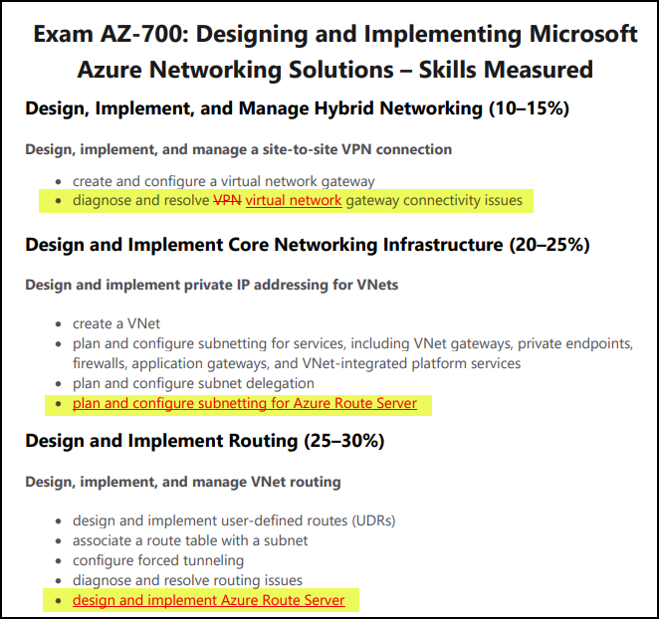
Exam AZ-700 Update: 23 Nov 2021

Slide 13
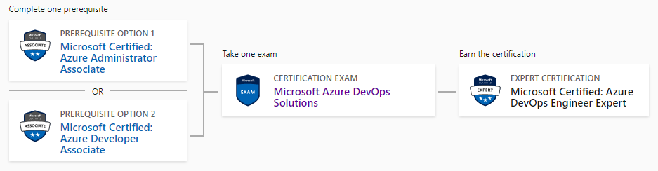
Related Certifications
AZ-104
AZ-400
AZ-204

Slide 14

Tim's Certification Study Model

Slide 15
Thank you!
Course materials: timw.info/az700
Twitter: @TechTrainerTim
Work: timw.info/ps
Web: TechTrainerTim.com

Slide 16
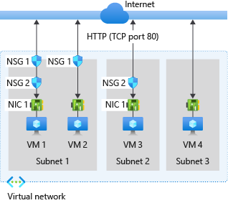
Multiple NSGs

Slide 17
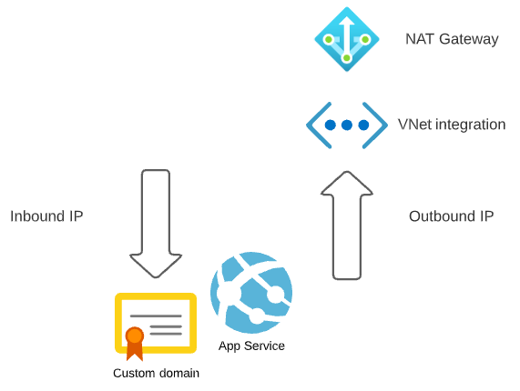
Azure App Service

Slide 18
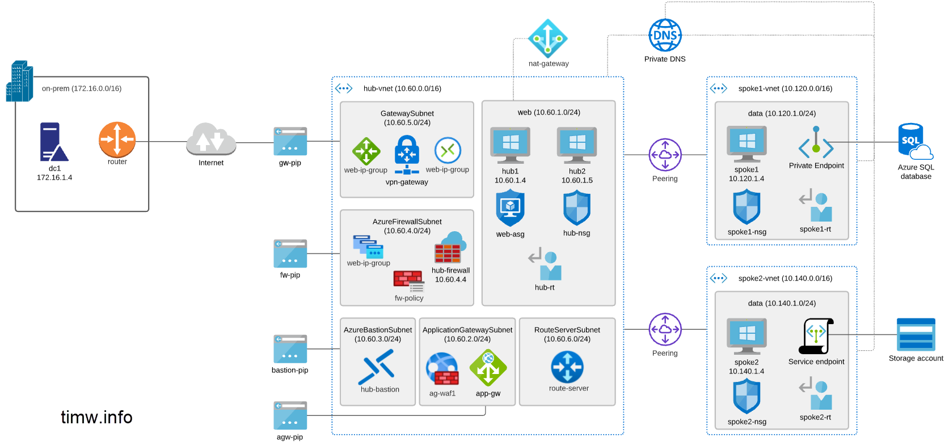
Azure Private DNS
168.63.129.16

Slide 19
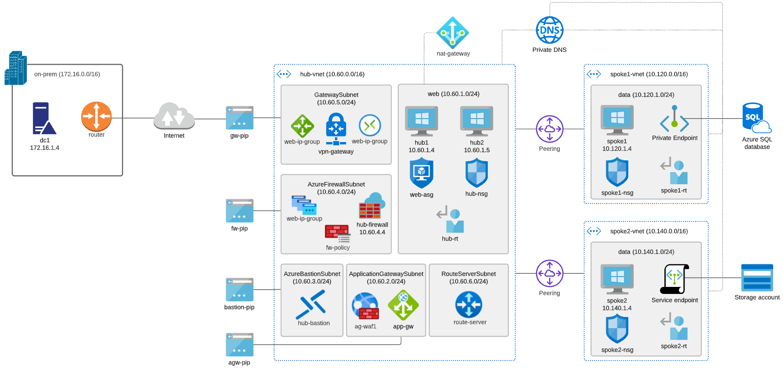

Our Network Topology

Slide 20

VM Networking

Slide 21

VNet Peering

Slide 22

Site-to-Site VPN

Slide 23
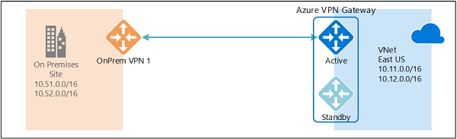
Active/Active VPN Topologies

Slide 24
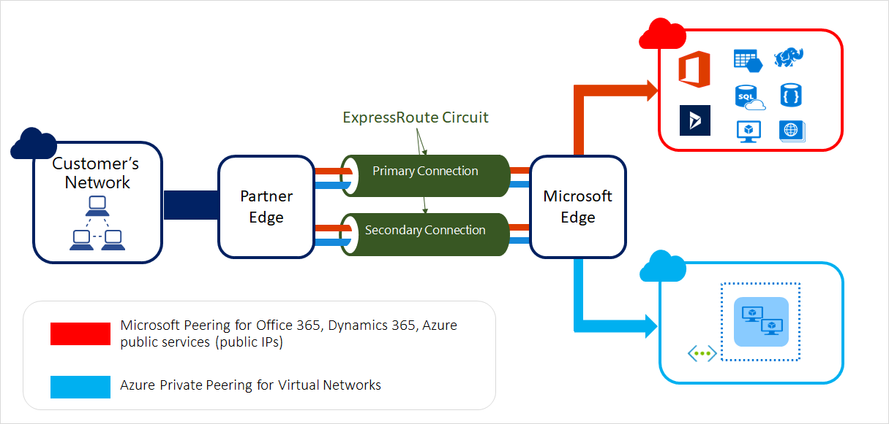
ExpressRoute Peering Types

Slide 25
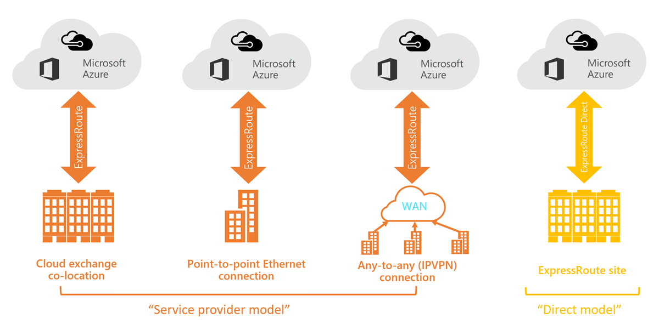
ExpressRoute Service Models

Slide 26
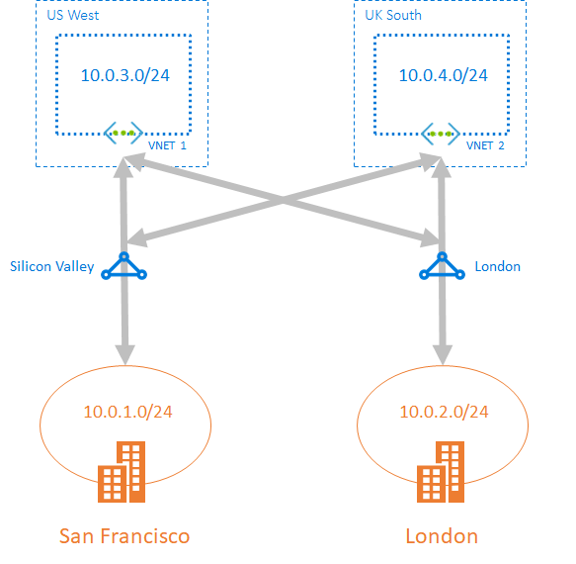
ExpressRoute Global Reach

Slide 27
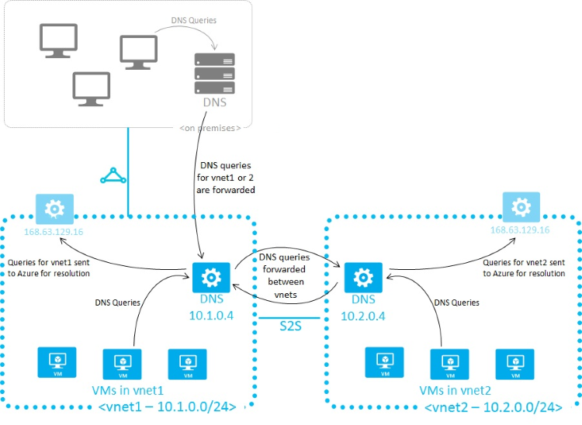
Azure Name Resolution

Slide 28
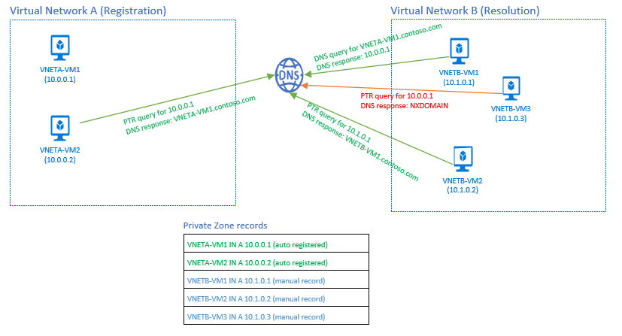
Azure DNS Private Zones

Slide 29
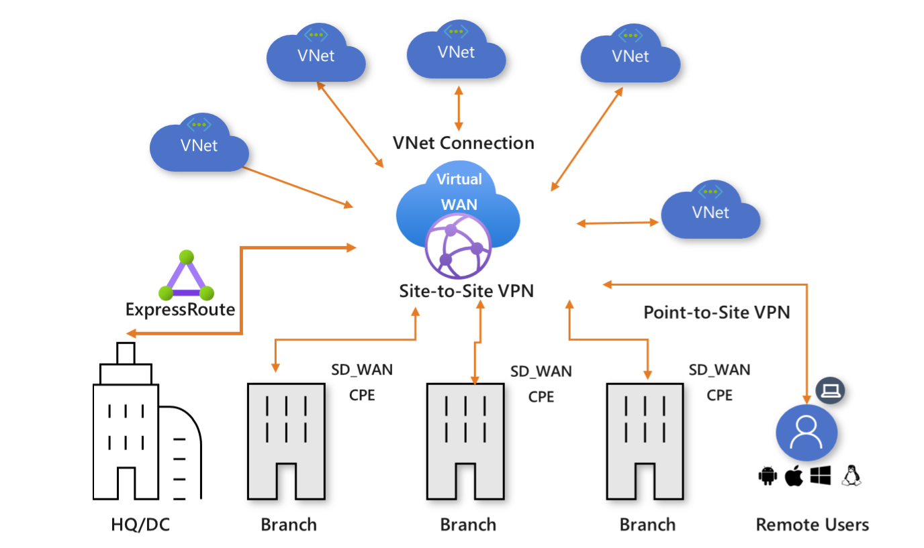
Virtual WAN

Slide 30
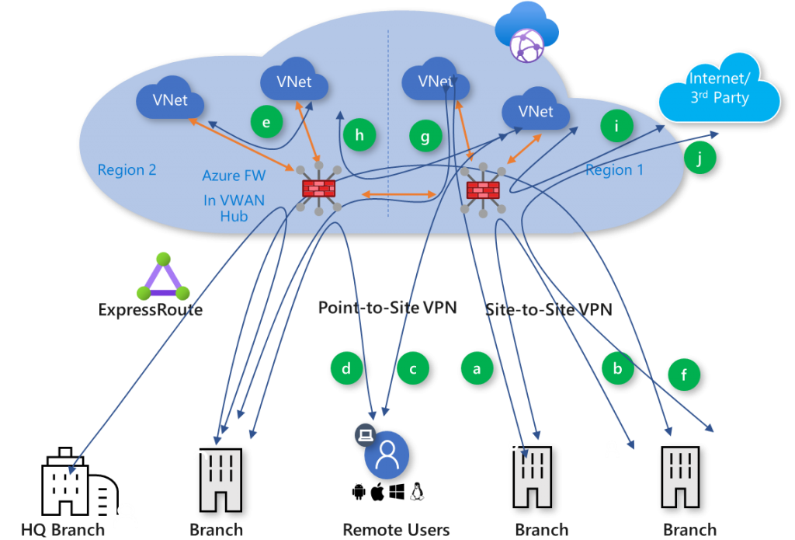
Secured Virtual Hub

Slide 31


Load Balancing

Slide 32

Network Virtual Appliance

Slide 33

Azure Load Balancer

Slide 34

Application Gateway

Slide 35
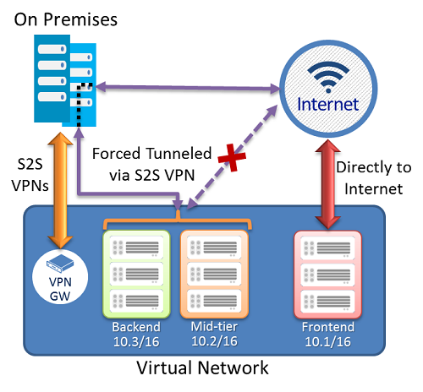
Forced Tunneling - S2S VPN

Slide 36
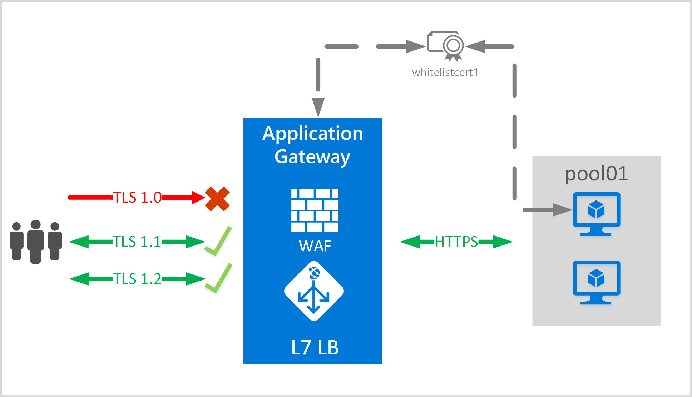

App Gateway E2E TLS

Slide 37
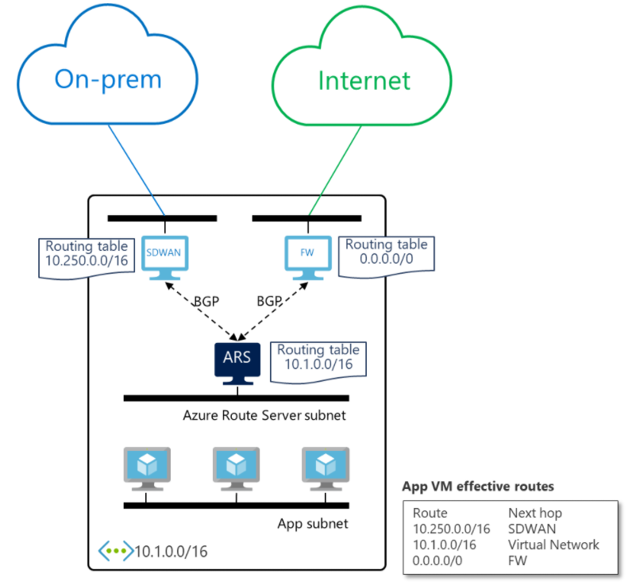
Azure Route Server

Slide 38
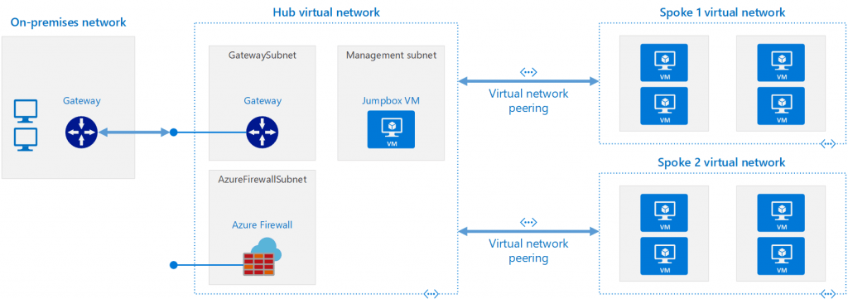
Network Virtual Appliance (NVA)

Slide 39
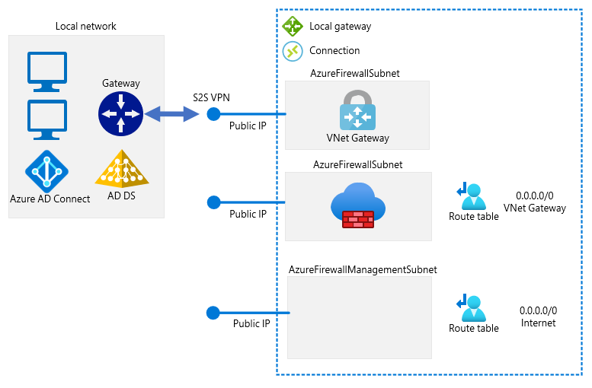
Forced Tunneling - Azure Firewall

Slide 40
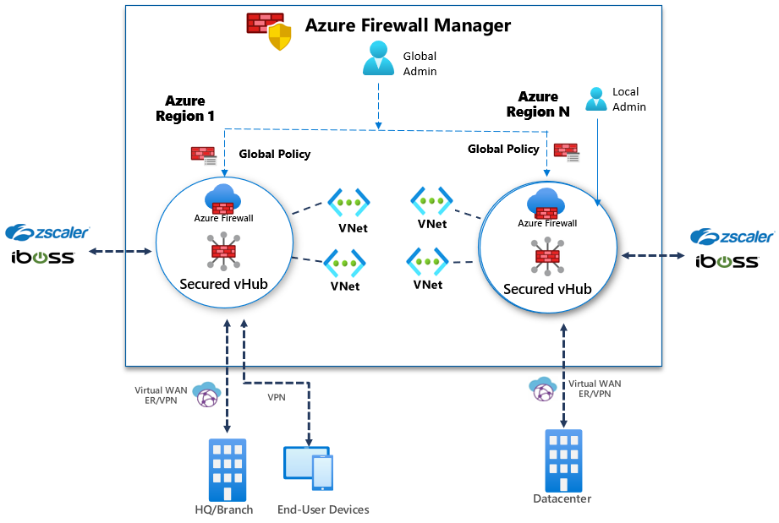
Azure Firewall Manager

Slide 41

Traffic Manager

Slide 42

Front Door Service

Slide 43
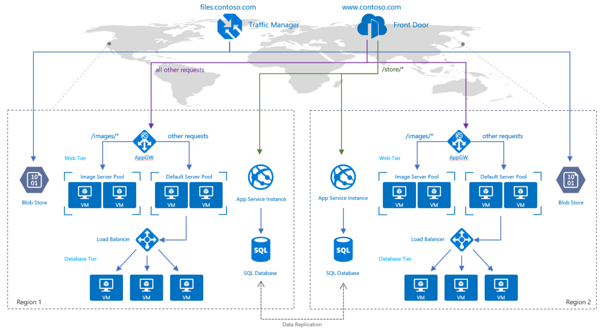
Traffic Manager vs Front Door

Slide 44
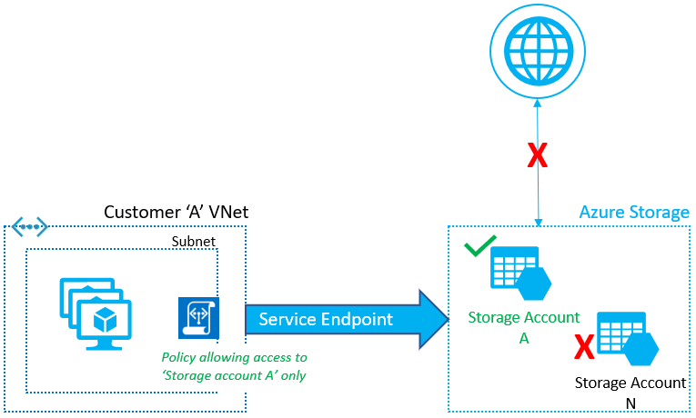
Service Endpoints

Slide 45
Private Endpoints

Slide 46
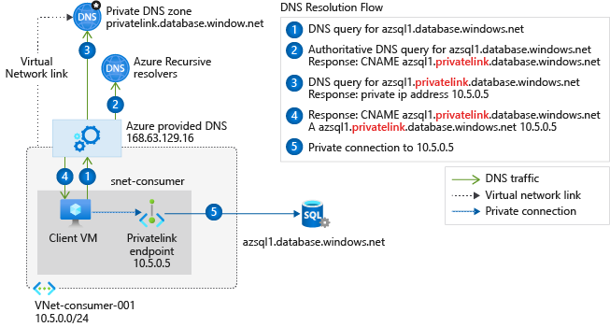
Private Endpoint DNS Config
Access from Azure

Slide 47
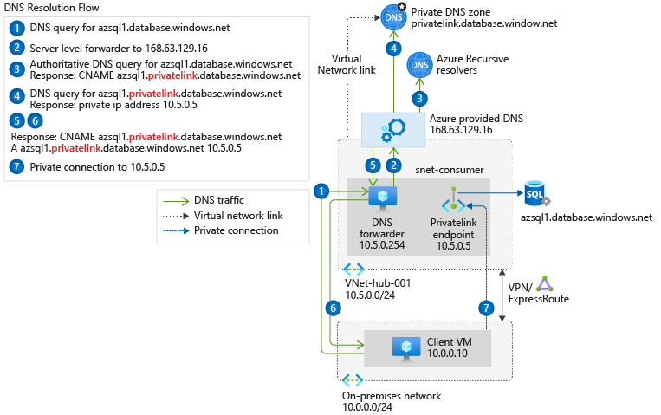
Private Endpoint DNS Config
Access from on-premises
Access from on-premises

Slide 48

Azure Monitor

Slide 49
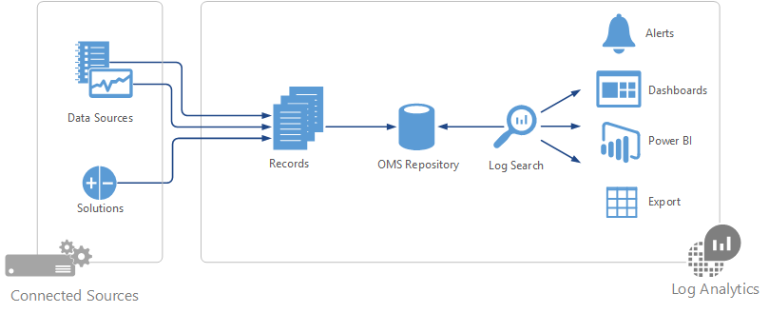

Log Analytics

Slide 50
Exam AZ-700 Item Types

Slide 51

Multiple Choice

Slide 52

Multiple Choice

Slide 53
Repeated Scenario
You need to move an Azure VM to another hardware host.
Solution: You redeploy the VM.
Does this solution meet the goal?
Yes
No

Slide 54
Repeated Scenario
You need to move an Azure VM to another hardware host.
Solution: You create a proximity placement group.
Does this solution meet the goal?
Yes
No

Slide 55

Select and Place

Slide 56

Build List and Reorder

Slide 57
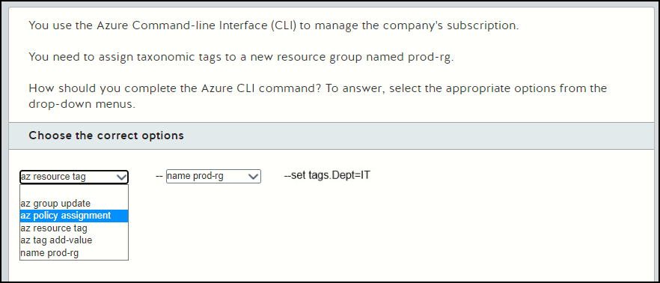
Active Screen

Slide 58

Case Study

Slide 59






Performance-Based Lab

Slide 60
Microsoft Online Testing Process
timw.info/online

Slide 61

Microsoft Online Testing Process

Slide 62

Microsoft Online Testing Process

Slide 63

Microsoft Online Testing Process

Slide 64

Microsoft Online Testing Process

Slide 65

Microsoft Online Testing Process

Slide 66

Microsoft Online Testing Process

Slide 67

Microsoft Online Testing Process

